Slide 1



Home
About Us
Services
Contact
FULL STACK PYTHON
A Complete Guide to Web Development, Application Architecture and Real-World Projects
Learn to design, develop, and maintain complete web applications using Python and modern development technologies.
From writing Python code to building scalable applications, this course introduces the concepts required to develop real-world software.
Launch It

Slide 2
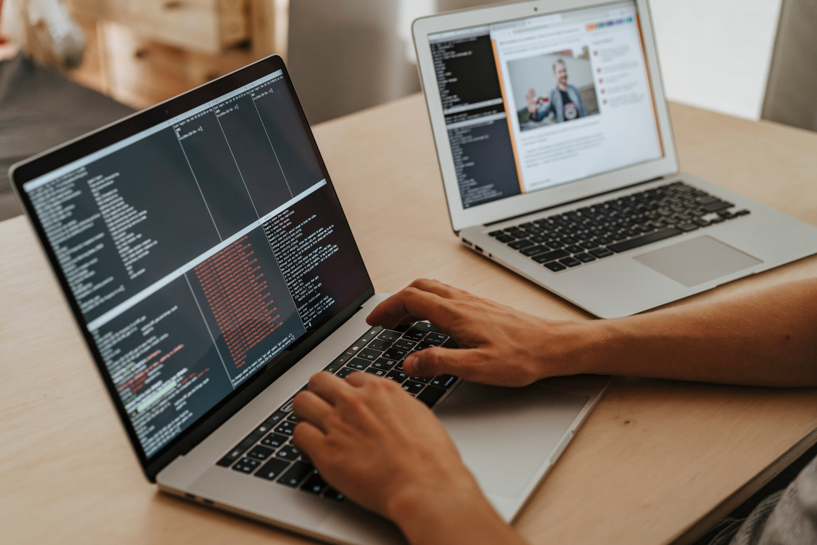
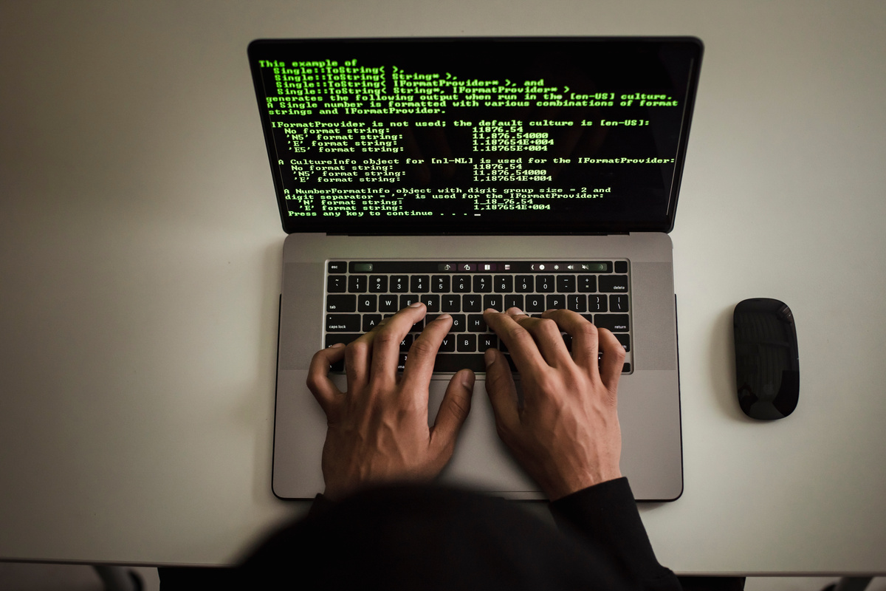
Home
About Us
Services
Contact
Defining the Role
A Full Stack Developer works on different parts of a web application, from the user interface to server-side functionality and data management.
Full Stack Developers understand how different components communicate and work together. They also need to understand application structure, code organization, and the complete software development process.
Main Responsibilities
  Understand application requirements
  Organize code into reusable components
  Connect different parts of an application
  Maintain and improve existing applications
WHAT IS A FULL STACK DEVELOPER?

Slide 3

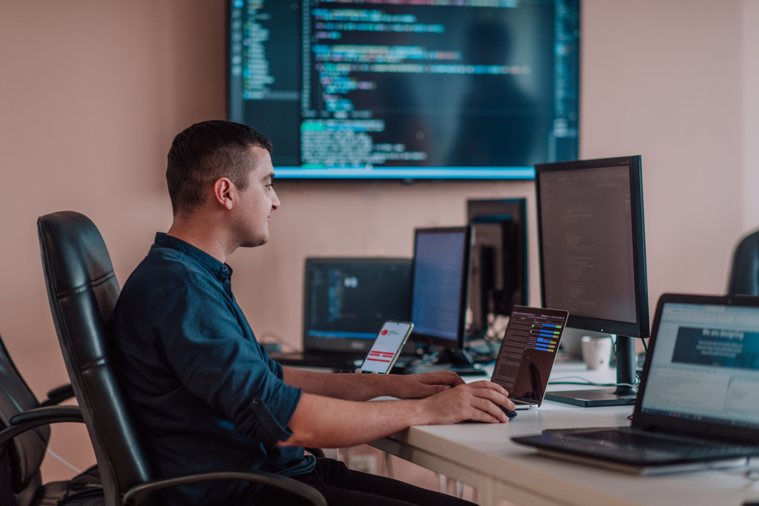
Home
About Us
Services
Contact
TYPES OF PROGRAMMERS
Specializations in Programming
Frontend Developer
Backend Developer
Programmers specialize in different areas based on the software they develop and the technologies they use. Some create websites, while others develop mobile apps, manage databases, or build intelligent systems. Each type of programmer plays an important role in creating and maintaining modern technology.
Creates the visual parts of websites that users interact with.
Develops server-side logic and manages databases.

Slide 4
Home
About Us
Services
Contact
Advanced Python Concepts
DECORATORS
Modify or extend the behavior of functions without changing their original code.
Generators
Produce values one at a time, helping process large amounts of data efficiently.
Advanced Python concepts help developers write efficient, reusable, and maintainable code. These concepts are useful when building large applications and working on complex programming tasks.
List Comprehensions
Create lists using concise and readable expressions.
Modules and Packages
Organize code into separate files and reusable components.
ADVANCED PYTHON CONCEPTS

Slide 5
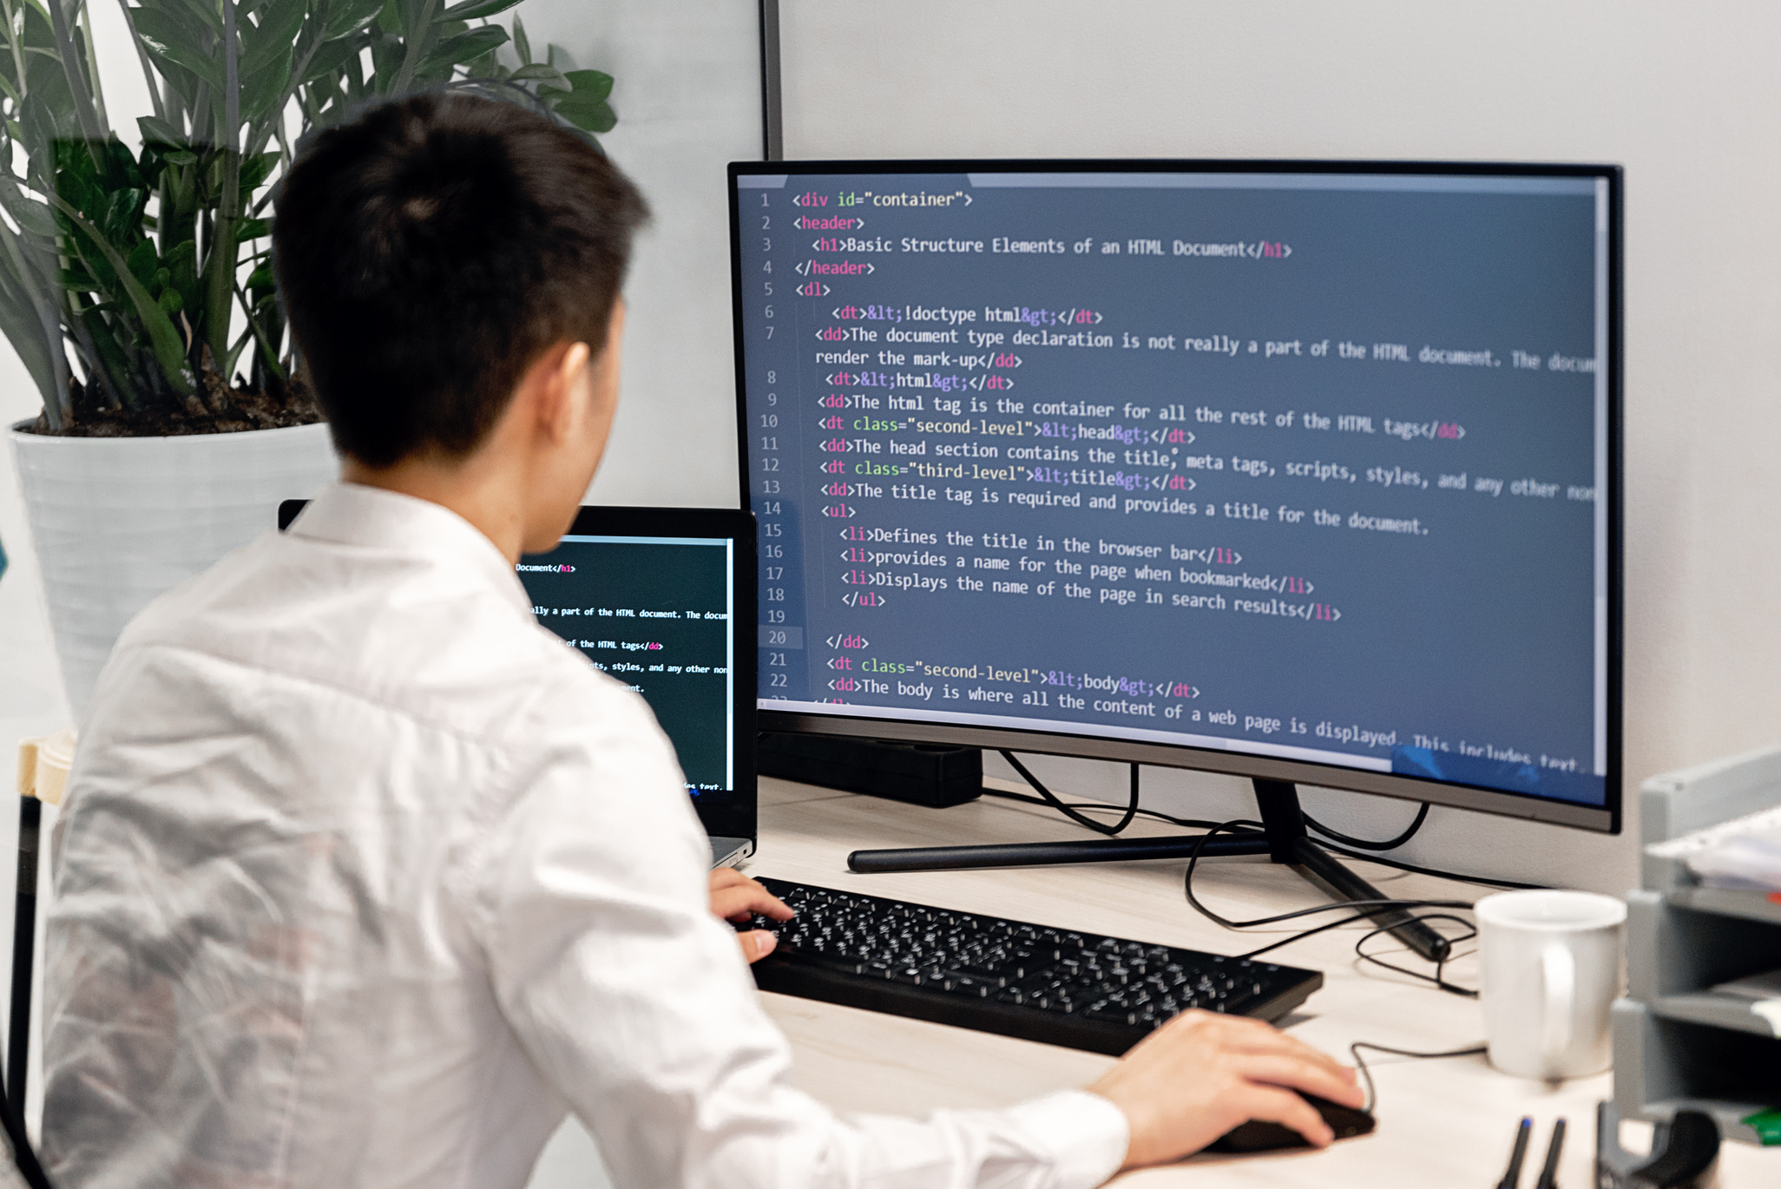
Home
About Us
Services
Contact
PYTHON WEB APPLICATION ARCHITECTURE
KEY ARCHITECTURE CONCEPTS
Application architecture explains how different components of a web application are organized and connected.
MVT Architecture
Django uses the Model-View-Template pattern to organize application logic, data handling, and presentation.
MVC Architecture
The Model-View-Controller pattern separates data, user interface, and application control logic.
ORM (Object-Relational Mapping)
ORM allows developers to interact with databases using Python objects instead of writing every SQL query manually.
Database Migrations
Migrations help manage changes to database structure as an application evolves.

Slide 6
Home
About Us
Services
Contact
Programming languages are used to develop websites, software applications, mobile apps, and computer systems. Each language has its own features and uses, depending on the type of project.
Python is known for its simple syntax and readability. It is used in web development, automation, data analysis, and artificial intelligence.
JavaScript is used to create interactive websites and dynamic user interfaces. It can also be used for backend development with Node.js.
Java is widely used for enterprise software, backend systems, and Android applications.
C++ is used in game development, system programming, and applications that require high performance.
C# is used to develop web applications, desktop software, and enterprise solutions with the .NET platform.
PHP is a server-side programming language used to build dynamic websites and web applications.
POPULAR PROGRAMMING LANGUAGES
The Building Blocks of Software
Python: Versatile and beginner-friendly
JavaScript: Vital for web development
Java: Ideal for enterprise solutions

Slide 7

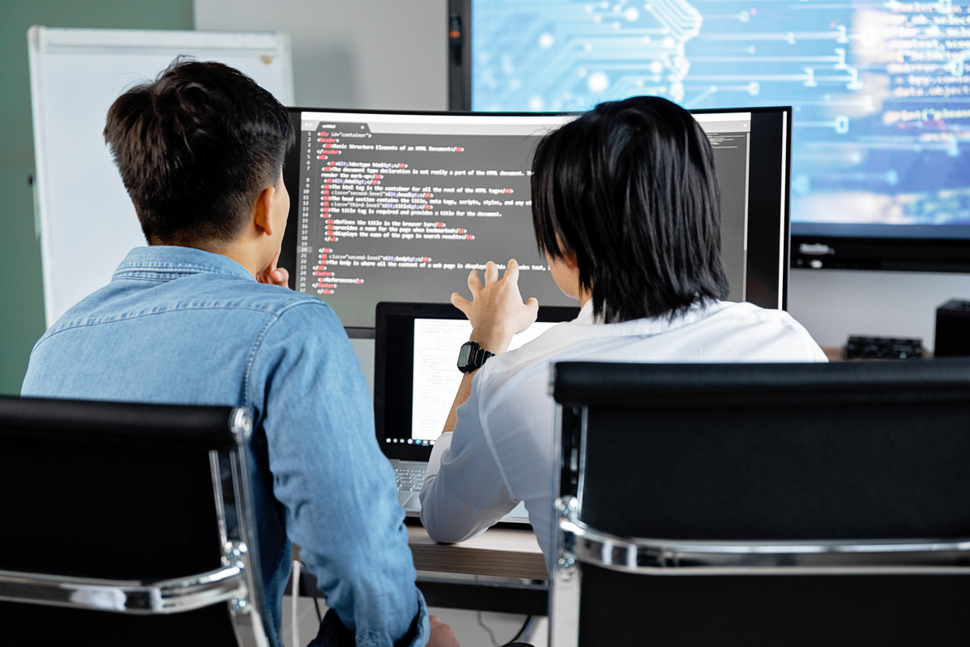
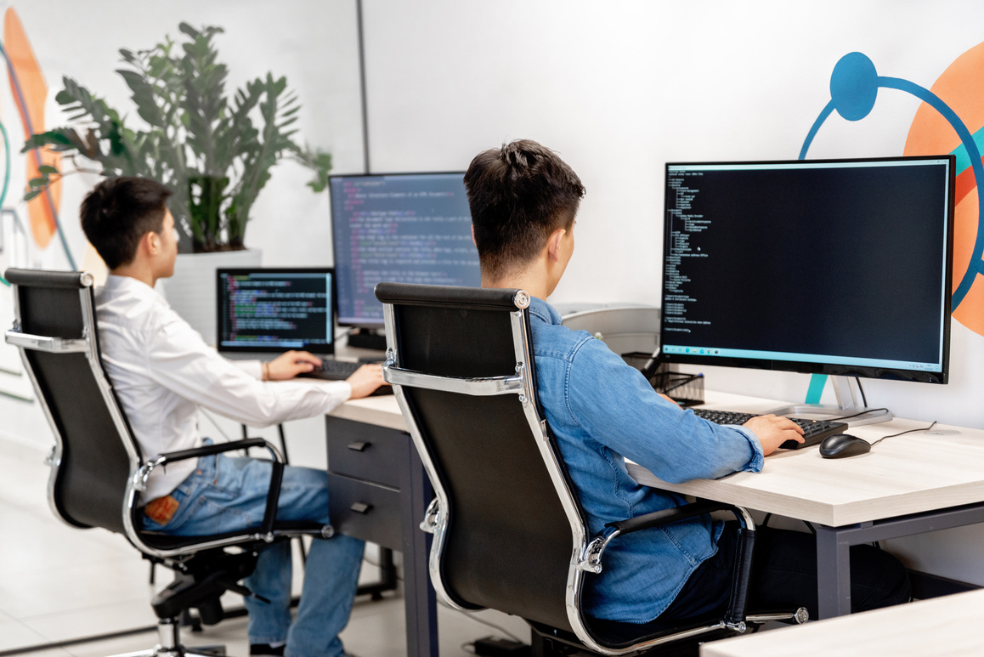
Home
About Us
Services
Contact
Remote and hybrid options are common
Collaborative work with designers and analysts
THE WORK ENVIRONMENT
Flexible schedules enable creative problem-solving
Where and How Programmers Work

Slide 8

Home
About Us
Services
Contact
Problems Faced by Python Developers
CHALLENGES PROGRAMMERS FACE
Programmers face several challenges while developing and maintaining software applications. Understanding these challenges helps developers find effective solutions and improve their coding skills.
1. Debugging Errors
Finding and fixing errors in code can take time. Programmers use debugging tools and testing techniques to identify problems and make applications work correctly.
2. Managing Complex Code
Large applications contain many files, functions, and components. Writing clean, reusable, and well-organized code makes projects easier to maintain.
3. Security Issues
Web applications may face risks such as unauthorized access, data leaks, and malicious attacks. Developers need to follow secure coding practices to protect application data.
4. Performance Optimization
Slow applications can affect user experience. Programmers improve performance by optimizing code, database queries, and resource usage.
5. Learning New Technologies
Programming tools and frameworks continue to evolve. Developers need to keep learning new technologies and updating their skills.

Slide 9

Home
About Us
Services
Contact
Advancing AI and automation technologies
Python helps developers build AI applications such as chatbots and recommendation systems. Automation reduces repetitive tasks, saves time, improves accuracy, and increases business efficiency.
THE IMPACT OF PROGRAMMERS
Empowering industries through tailored applications
Python helps industries develop applications based on their specific needs. Businesses use these applications to manage data, improve daily operations, serve customers, and increase productivity.
Shaping the Digital World
Facilitating global communication with apps and platforms
Python helps create apps that connect people worldwide through messaging, video calls, and information sharing.

Slide 10
Home
About Us
Services
Contact
HOW TO BECOME A PROGRAMMER
Facilitating global communication with apps and platforms
Build a portfolio to showcase your projects
Steps to Start Your Journey
Becoming a programmer starts with learning the basics of programming languages like Python. Practice coding regularly, understand problem-solving techniques, and build small projects to improve your skills. Learn to find and fix errors, explore new technologies, and create a portfolio to showcase your work. With consistent practice and hands-on experience, you can build a strong foundation for a programming career.
Steps to Get Started
  Learn Programming Basics
  Practice Coding Regularly
  Build Real-World Projects
  Develop Problem-Solving Skills
  Create a Project Portfolio
Gain experience through internships or freelancing

Slide 11



Home
About Us
Services
Contact
THANK YOU
Get In Touch
+91 63745 10754
https://code99itacademy.com/

